Slide 1


KICKSTATER CROWDFUNDING
PRESENTED BY:
Raseem Muhammed M

Slide 2
CONTENTS
INTRODUCTION
KEY FEATURES
DATA OVERVIEW
KPI
CONCLUSION
DASHBOARDS

Slide 3
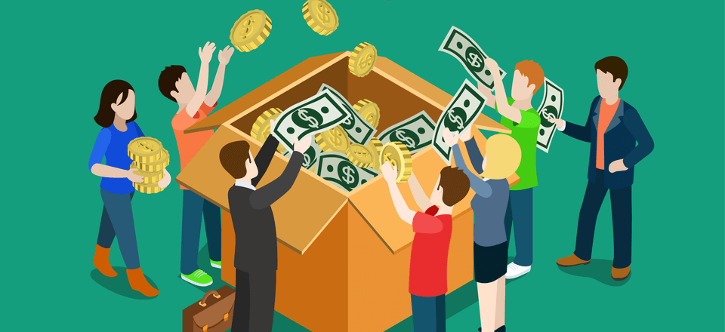
INTRODUCTION
Crowdfunding is a method of raising funds by collecting small contributions from a large number of individuals , typically via online platforms , to support a project , business, or cause.
Kickstarter is a leading crowdfunding platform where creators raise funds for projects through public support. It follows a reward-based, all-or-nothing model, helping entrepreneurs and artists turn ideas into reality.

Slide 4
TYPES OF CROWDFUNDING MODELS
Donation-Based Crowdfunding: This model allows supporters to donate funds to various projects without anticipating any financial return, commonly utilized for charitable initiatives.
Rewards-Based Crowdfunding: In this approach, backers receive non-monetary rewards in return for their contributions, often associated with creative endeavors.
Equity-Based Crowdfunding: This type permits backers to invest in businesses in exchange for equity or shares, which may lead to potential financial gains.
Debt-Based Crowdfunding: Here, backers lend money to projects or businesses, expecting repayment along with interest.

Slide 5
WHY CROWDFUNDING?
Provides access to capital without loans or venture capital.
Engages and builds a loyal community of supporters.
Offers market validation before full-scale production or launch.
Encourages innovation and creativity through public involvement.

Slide 6
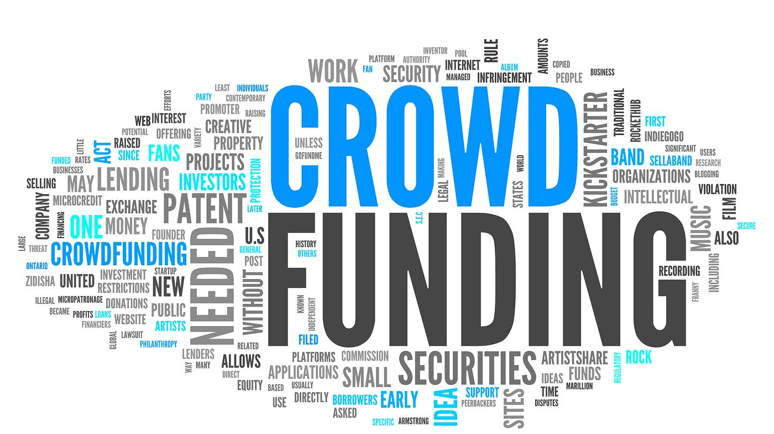
KEY FEATURES
Community-Driven: Relies on support from individuals rather than traditional investors.
Online Platforms: Uses websites like Kickstarter ,Indiegogo and Go Fund Me.
Diverse Purposes: Supports startups, creative projects, social causes and innovations.
Multiple Models: Includes reward-based, donation-based, equity-based, and debt-based crowdfunding.
Global Reach: Allows anyone, anywhere to contribute and support.

Slide 7
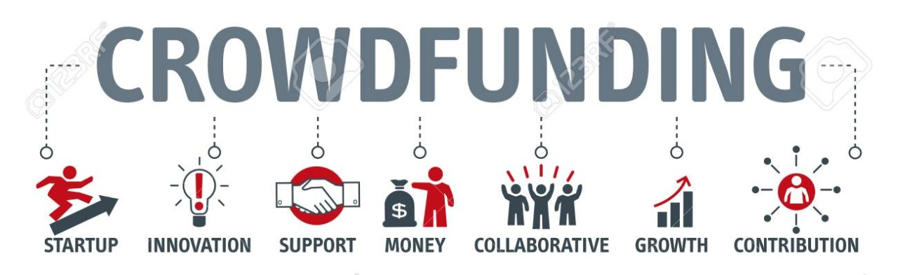
DATA OVERVIEW
Global Crowdfunding Market Size: Valued at ~$17.2B in 2021, expected to grow to $43.5B by 2028.
Success Rate: On Kickstarter, ~39% of projects reach their funding deedroals.
Top Industries: Technology, arts, social causes, and consumer products.
Largest Campaigns: Pebble Smartwatch ($10M+), Oculus Rift ($2.4M), Charity Water ($50M+ in total donations).

Slide 8
Key Performance Indicators (KPIs)
Definition: Key Performance Indicators (KPIs) are measurable values that demonstrate how effectively an individual, team, or organization is achieving a business objective.
Purpose of KPIs: KPIs provide measurable data to guide decision-making and assess the performance of various aspects of a business or project.

Slide 9
USES OF KPIs
Monitor Trends:
Track progress over time.
Make Comparisons: Compare different categories or time periods (e.g., year over year).
Set Targets:
Set benchmarks and goals based on KPI performance.
Drive Action:
Encourage proactive measures based on KPI data.

Slide 10
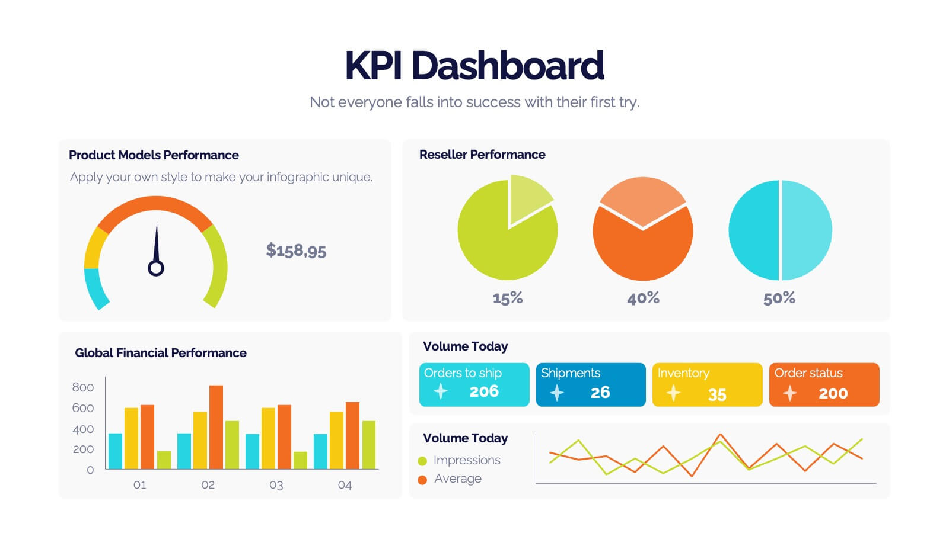
Importance of KPIs in Dashboards
Data-Driven Decisions
Tracking Progress
Goal Alignment
Early Detection of Issues

Slide 11
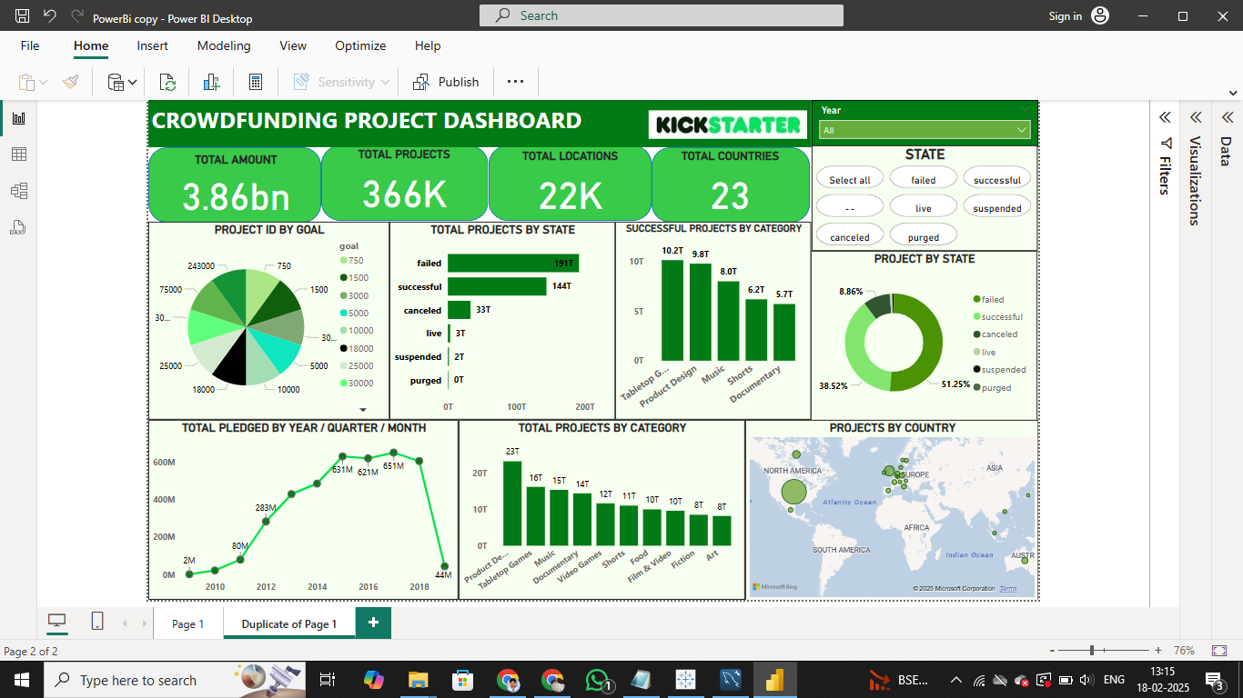
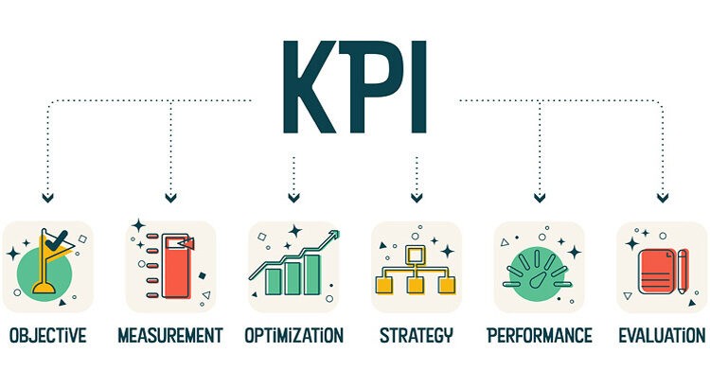
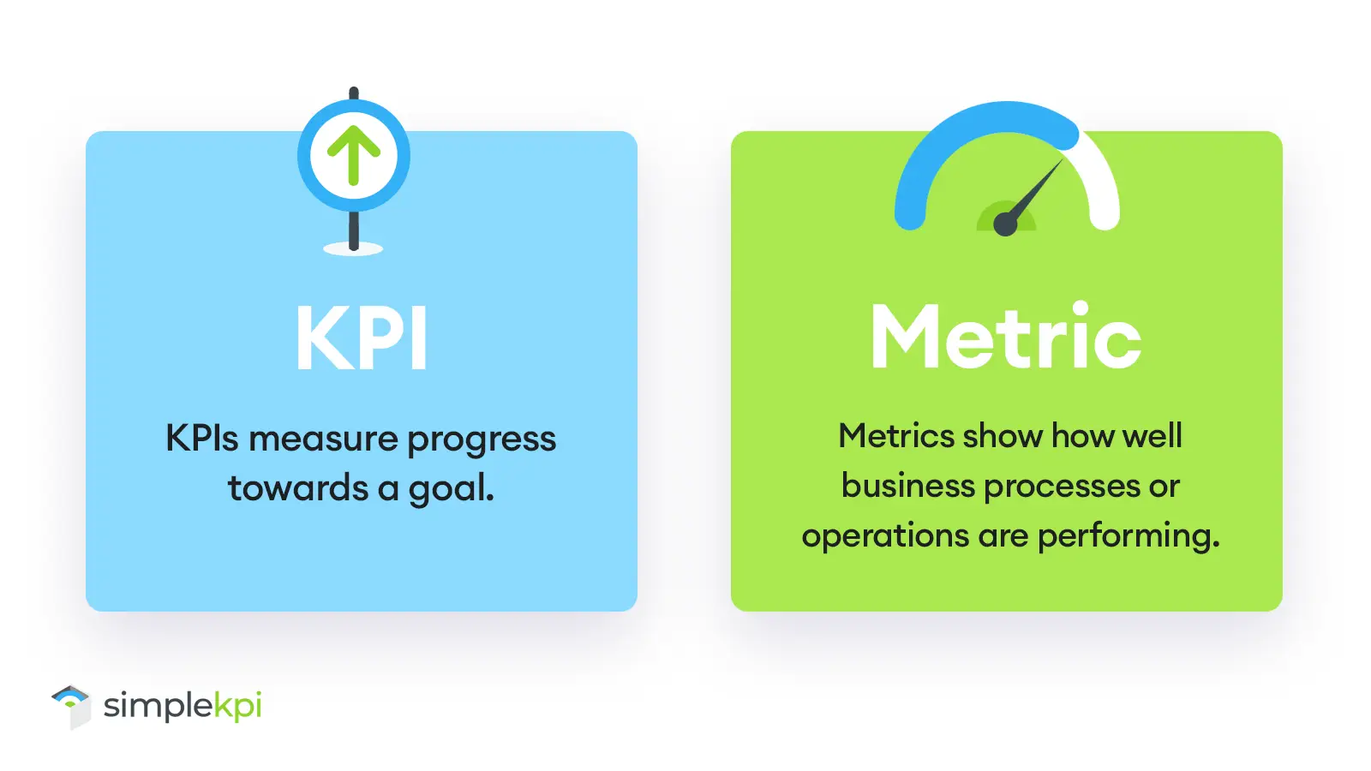
KPIs USED IN DASHBOARD
Total Number of Projects based on Outcome
Total Number of Projects based on Locations
Total Number of Projects based on Category
Total Number of Projects Created by Year, Quarter, Month
Amount Raised by Number of Backers
Average Number of Days for Successful Projects

Slide 12
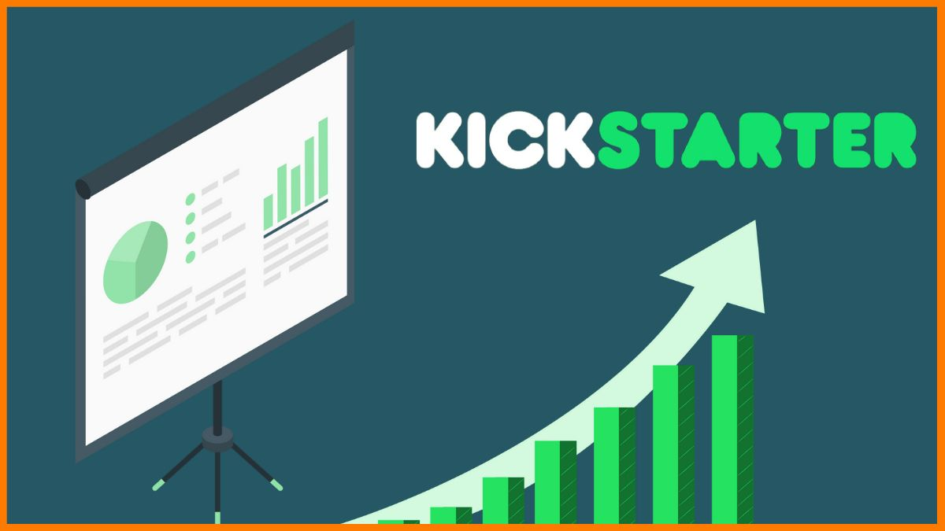
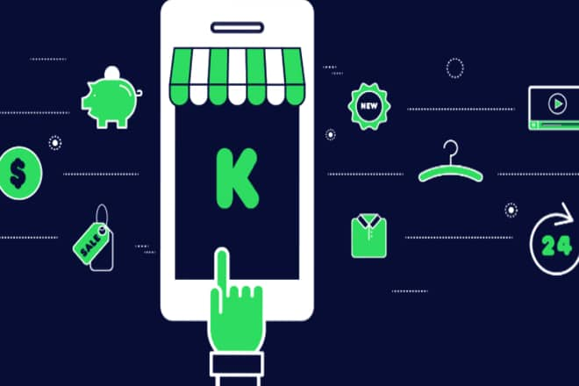
CONCLUSION
Crowdfunding has revolutionized fundraising by enabling individuals and businesses to gather financial support from a wide audience. It offers a flexible and accessible way to launch projects, develop products, or support social causes. With the right strategy, transparency, and community engagement, crowdfunding can successfully turn innovative ideas into reality.

Slide 13
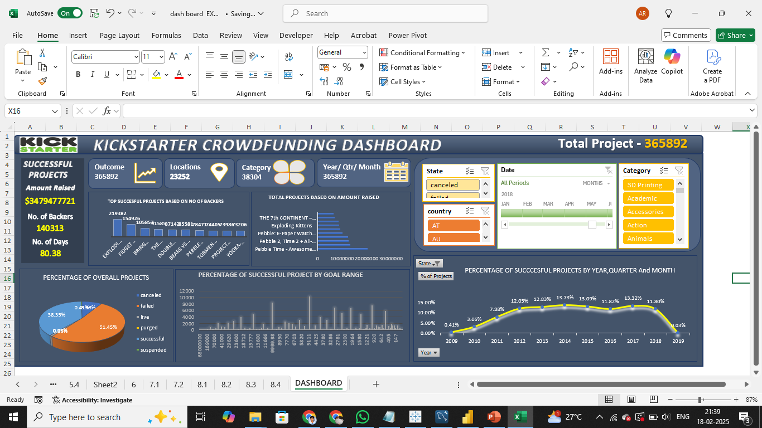
EXCEL DASHBOARD

Slide 14
POWERBI DASHBOARD

Slide 15
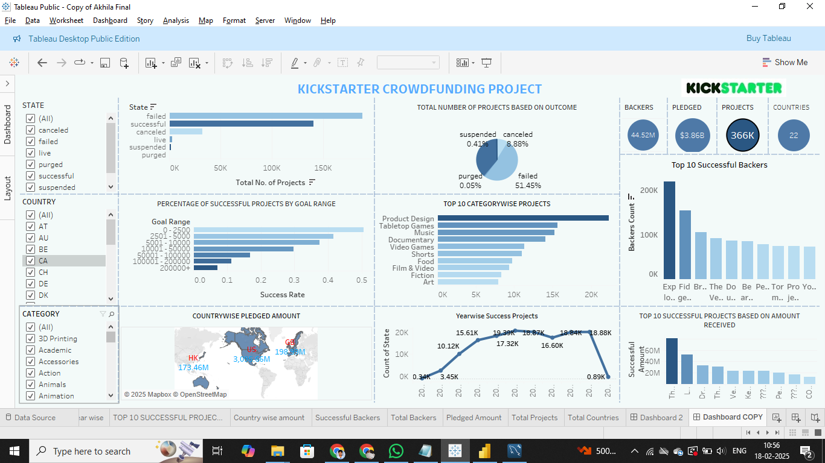
TABLEAU DASHBOARD

Slide 16

THANK YOU…

